Slide 1
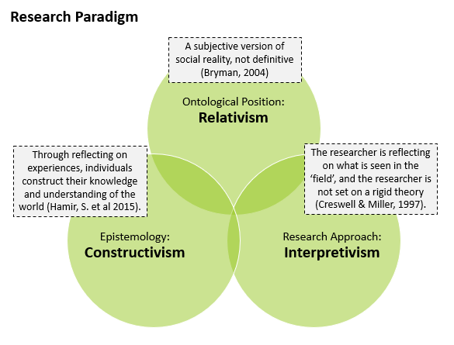
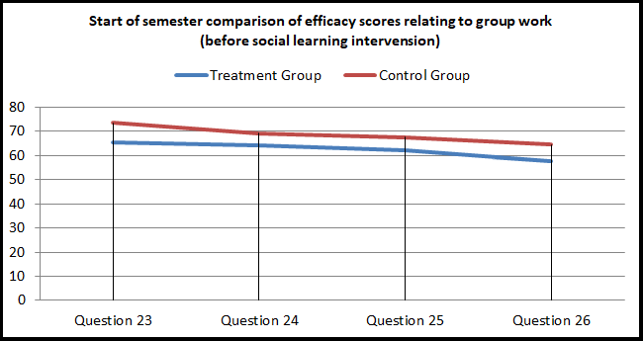
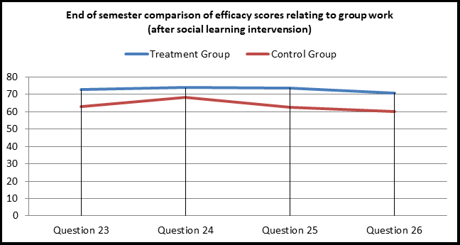
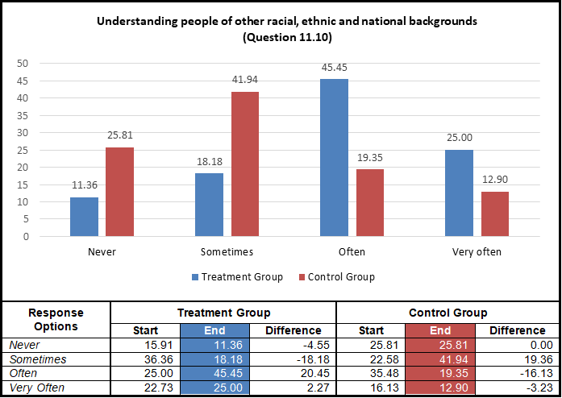
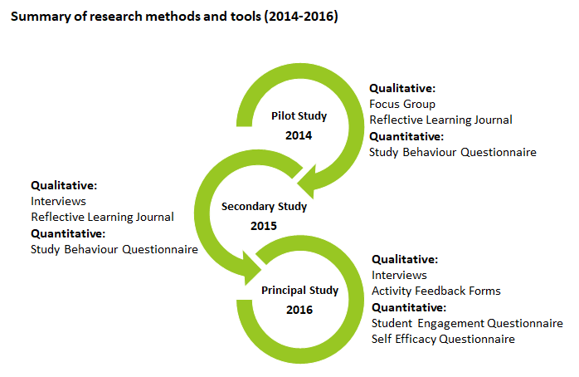
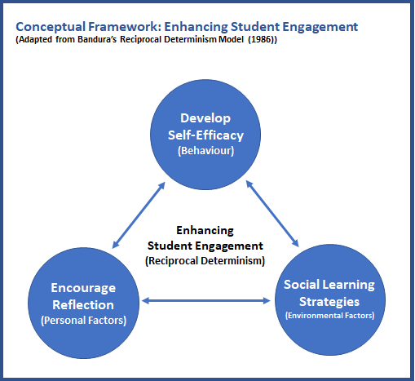
Cultivating Academic Self-Efficacy through supportive social and self-regulated learning strategies
for students in higher education
Erick da Silva Zumba, CCT College Dublin (Bsc Cohort 9), Nov 2024
ABSTRACT
RESEARCH PARADIGM
FINDINGS
Self Efficacy
The main goal of working with a dataset is to maximise the potential of the data and potentially insert this information into AI and subsequently to ML. The research goal was to gather any data and transform it to something useful, for example, a resource to feed the AI. This is a powerful tool and needs accurate information. The process of inputting this information using AI is still new. Whereas, where there is human input into the data inputting process this can result in mistakes due to human error. Whereas, when using this process with AI, the chances of these mistakes being made are greatly lowered, if not eliminated completely. For instance, the current use of AI within the medical field to accurately perform surgical procedures. The risk of accidents is significantly less than when being performed by a human surgeon.
The empirical research studies were based on an interpretative approach, which allowed for greater freedom to include personal views and interpretations, and to form knowledge inductively from views and experiences of participants. The diagram below characterises the research paradigm for this study, which can be described as a loose collection of logically related assumptions, concepts, or propositions that orient thinking and research (Bogdan and Biklen, 1998).
Reflective Learning
Participants were provided a self-efficacy questionnaire, based on a approach suggested by Bandura (2006), to complete at the start and end of a semester. A social learning intervention was introduced to a treatment group, and the overall self-efficacy group score comparison revealed very little, other than a slight increase in the treatment group score. However, a significant finding was found when comparing the final four questions measuring the perceived ability to work within a group. To illustrate this, the first figure below represents the start of semester self-efficacy group score for both groups, followed by the second figure representing the end of semester self-efficacy score reversal.
A reflective learning journal was provided to student participants in two of the action research studies, participants were asked to complete this journal on a weekly basis over the course of a semester. There was mixed opinions on the use of the journal, with the majority questioning its usefulness. Students were not convinced of the benefits of using the journal over a long period of time, and found the activity a burden in some cases. Some viewed it as a piece of additional assessment that had no grade, furthering most to question the benefits. While some positive benefits were noticed, careful consideration is required if using such a tool for a class cohort, some individuals seemed to adapt better to this type of journaling activity than others.
Student Engagement
RESEARCH QUESTIONS
A student engagement measurement tool was provided to student participants at the start and end of a semester. A social learning intervention was applied to a treatment group, and the engagement scores across both the control and treatment groups were measured. The results revealed a small increase in total student engagement group score for the treatment group, but nothing significant. However, interesting findings were found in some of the individual questions, the figure below represents one an example of this, in which the treatment group had scored considerably higher than the control group in a question relating to understanding people dissimilar to themselves, which would have been influenced through the social learning activities that the treatment group participated in. This, in itself, was an encouraging finding.
The four questions below represent the core focus of the entire study:
Q.1. Is a Reflective Learning Journal a useful and effective tool for engaging students in computer programming?
Q.2. Can the use of social learning strategies enhance student engagement?
Q.3 Are social learning strategies, such as Problem Based Learning and Peer Assisted Learning, effective tools in engaging students in computer programming?
Q.4 Can the use of social learning strategies enhance self- efficacy in computer programming?
Research Methods
The diagram below highlights the methods and tools used over the course of the action research study.
CONCEPTUAL FRAMEWORK
The conceptual framework below, was developed from Bandura’s (1986) Reciprocal Determinism model, in which Behaviour, Environmental Factors and Personal Factors were replaced with Self-Efficacy, Social Learning and Reflection, which became the basis for developing implementation strategies to enhance student engagement.
CONCLUSIONS
A summarised answer to the research questions are presented below:
Q.1. Both of the studies on the use of a reflective learning journal were mostly negative, in that students did not find it beneficial, and in some cases, saw it as an additional ungraded piece of assessment .
Q.2. There was evidence to suggest it does, specifically relating to group based activities, and communicating with peers. However, it is difficult to say positive findings were directly linked to the social learning activities introduced over the semester.
Q.3 The use of PBL and PAL was very successful in engaging students in computer programming, the students engaged in the activities and requested more of these activities in the future.
Q.4 There was no strong evidence to suggest social learning improved self-efficacy in computer programming, however, there was strong evidence found that participating in group work enhances self-efficacy in working with others in group activities.
Data Collection
Social Learning (PBL and PAL activities)
The table below is a summary of the data collected for the study.
Problem Based Learning (PBL) and Peer Assisted Learning (PAL) were introduced to a treatment group over the course of a semester. The quotes below represent a small sample of the overall positive feedback the participants expressed in terms of their enjoyment in participating in groups when solving programming problems:
“I learned I can work in a group. Although I most of the times would rather work alone, working in a group does make problem solving a lot easier”.
“I enjoy programming but I’m 100% aware that my planning skills are way better than my programming skills. I wish we had more opportunities like this one to practice”.
“Really enjoyable as I am better working with people. (I’m a really nervous person and individual evaluations makes me so nervous that I cannot concentrate)”.
“These activities really makes more interaction among friends and for a given problem, we can solve it with many the best ways. And need to be continued in the coming weeks”.
Pilot Study - 2014 | Analysis | Sample
Student study habits questionnaire | Quantitative | 31
Reflective Learning Journal | Qualitative | 77
Focus group (reflective journal evaluation) | Qualitative | 7
Secondary Study - 2015 | Analysis | Sample
Student study habits questionnaire | Quantitative | 53
Reflective Learning Journal | Qualitative | 18
Interview (Journal evaluation and Study habits) | Qualitative | 4
Principal Study - 2016 | Analysis | Sample
Student Engagement & Self-Efficacy Questionnaire – (Treatment Group) | Quantitative | 44
Student Engagement & Self-Efficacy Questionnaire –(Control) | Quantitative | 31
Interview (start and end of semester with principal programming lecturer ) | Qualitative | 1
Interview (end of semester with treatment group participants) | Qualitative | 4
PBL/PAL activity feedback forms (5x sessions) | Qualitative | 46
REFERENCES
Bandura, A. (1986). Social Foundations of Thought and Action: Social Cognitive Theory. U.S.A: Pearson Education.
Bandura, A. (2006). Guide for constructing self-efficacy scales. In F. Pajares, & T. Urdan (Eds.), Adolescence and education: Vol. 5. Self efficacy and adolescence (pp. 307-337). Greenwich, CT: Information Age.
Bogdan, R.C., Biklin, S.K. (1998). Qualitative research for education: An introduction to theory and methods. (3rd edition). Boston: Allyn and Bacon.
Bryman, A. (2004). Social Research Methods. U.K.: Oxford University Press.
Creswell, J.W., Miller, G.A. (1997). Research Methodologies and Doctoral Process. New Directions for Higher Education, no.99. U.S.A.: Wiley.
Hamir, S., Maion, S., Tice, S., & Wideman, A. (2015) Constructivism in
Education. Available at: http://constructivism512.weebly.com . Accessed 27th February 2018.
Miles, M.B., & Huberman, A.M. (1994). Qualitative data analysis: A sourcebook of new methods. Thousand Oaks, CA: Sage.

